Slide 1
Introduction to R
The basics
Daniel J Carter (he/him)
(with thanks to Andrea Mazzella)
27th July 2021

Slide 2
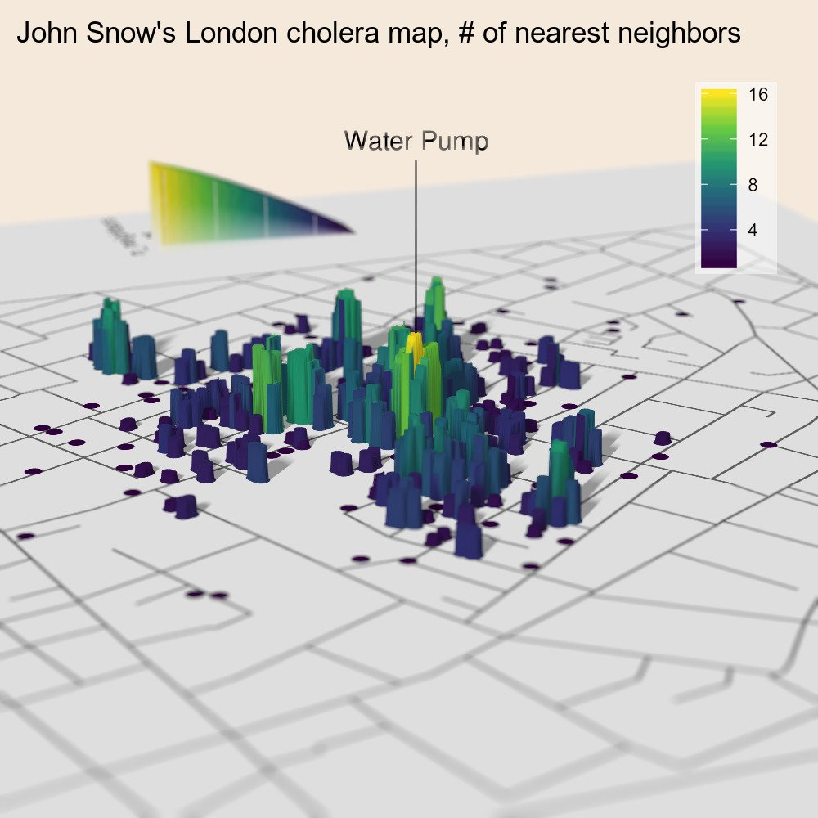
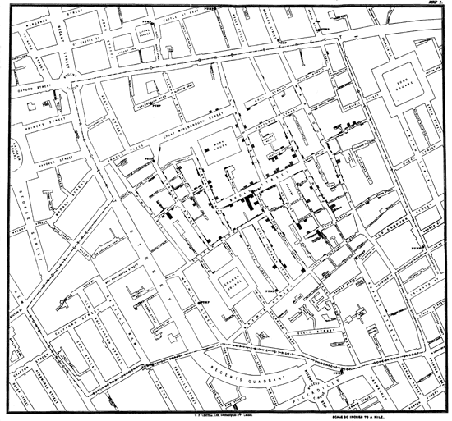
Why R?
Code from tylermorganwall on their github
.

Slide 3
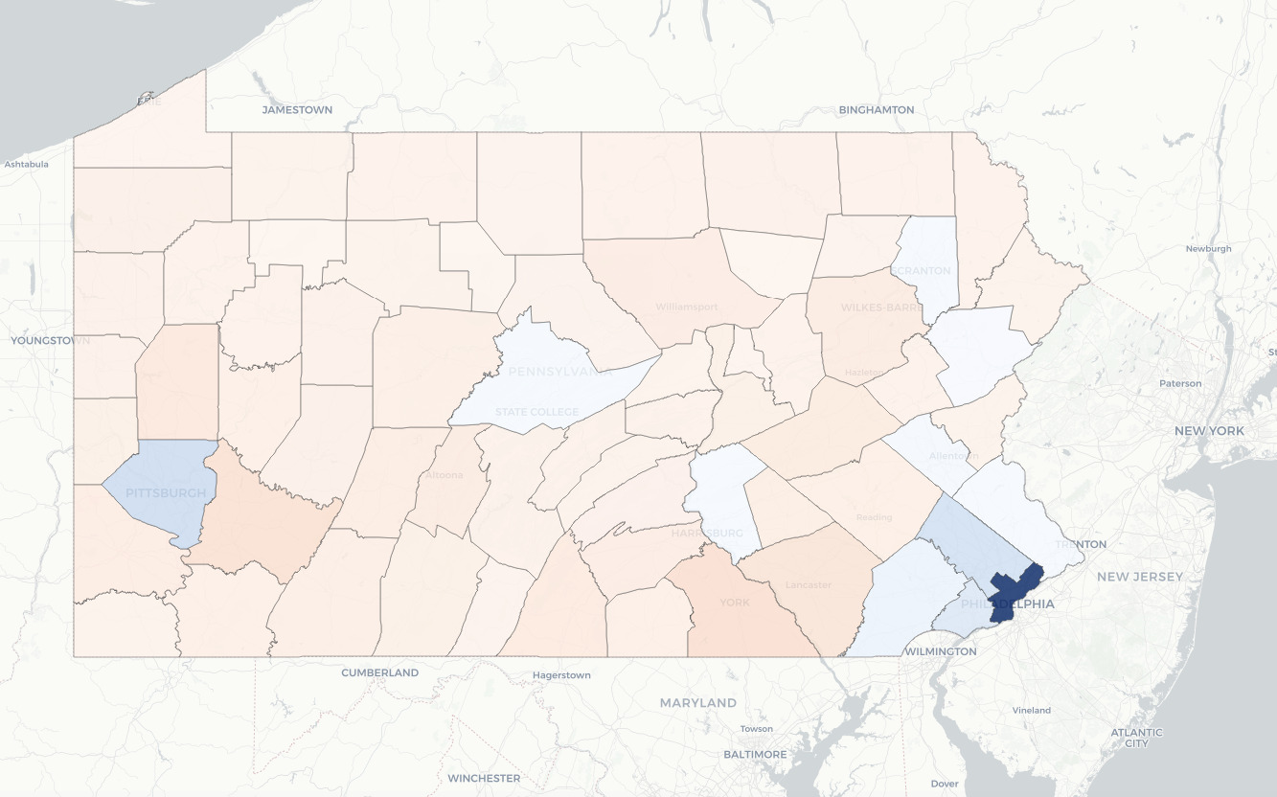
Two more…
NYT: Mapping Poverty in America
Code from smach on their github

Slide 4




Other reasons?
COVID modelling: “The post-holder must have the ability to program in a suitable language, such as R (preferred), Python, C/C++ or Visual Basic. ”
.
.

Slide 5


Download and install – see getting started guide
1. Download: cran.ma.imperial.ac.uk
2. Install
3. Download: rstudio.com/products/rstudio/download – free version
4. Install
.
.

Slide 6
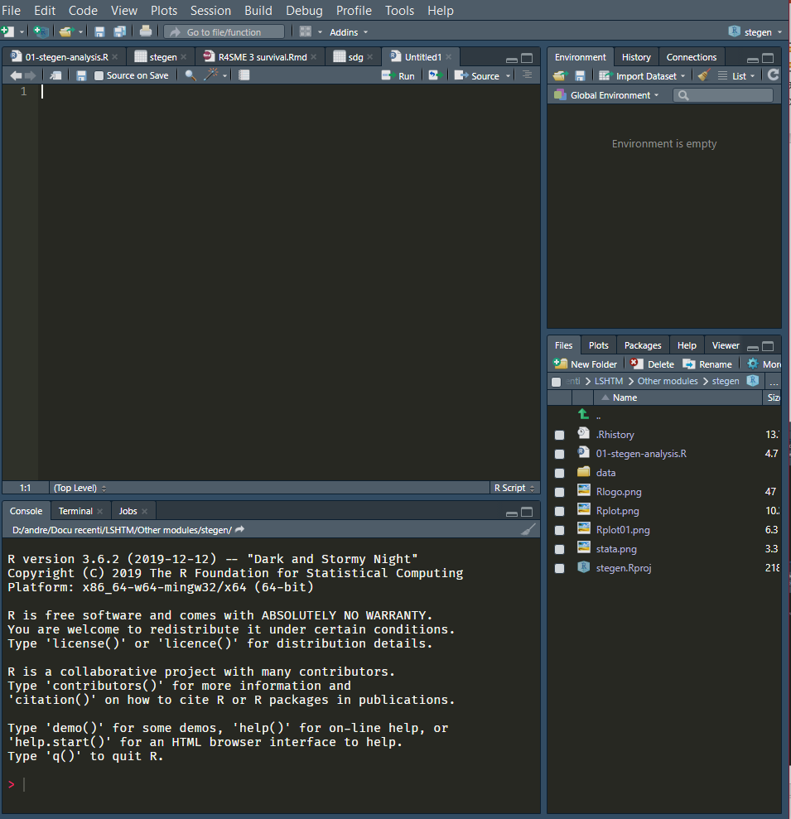
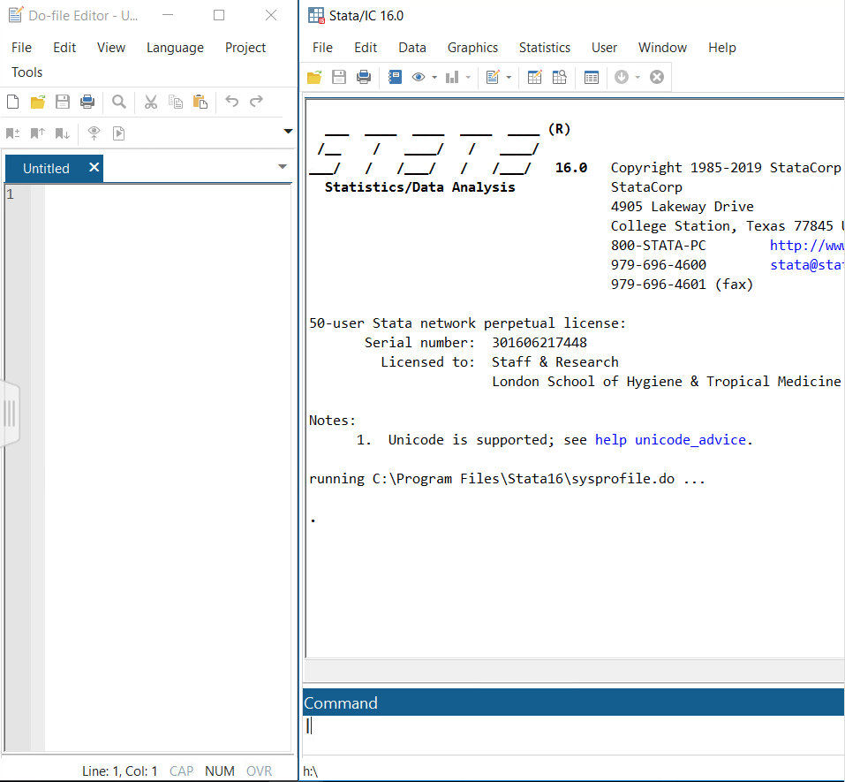
General organisation
environment
R script / notebook
do file
output
output
console
command
.
.

Slide 7
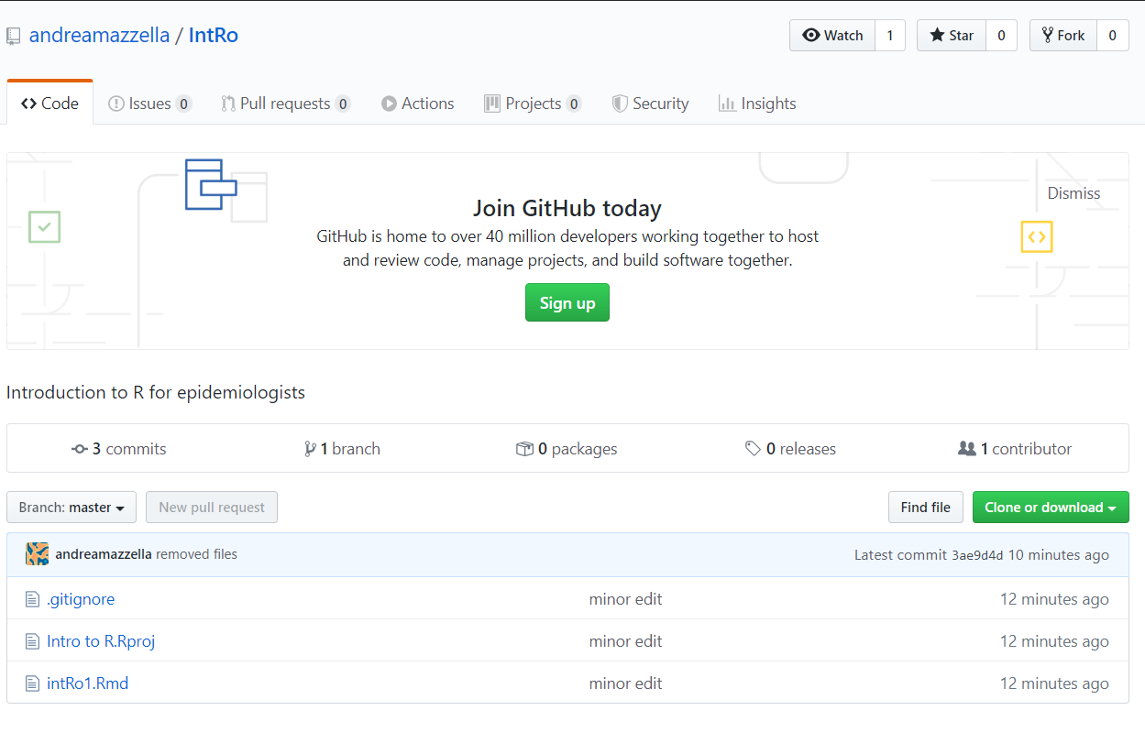
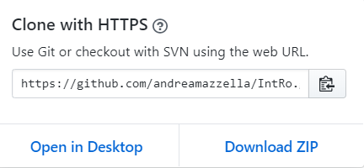
Using github
https://github.com/danieljcarter/r4lshtm
.
Unzip and open the .Rmd file with RStudio
.

Slide 8
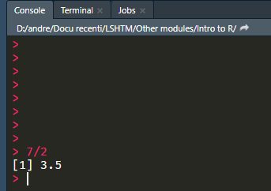
a) Console
Type your command next to the >, then press enter.
Output will appear in the console
& forget about it
.

Slide 9
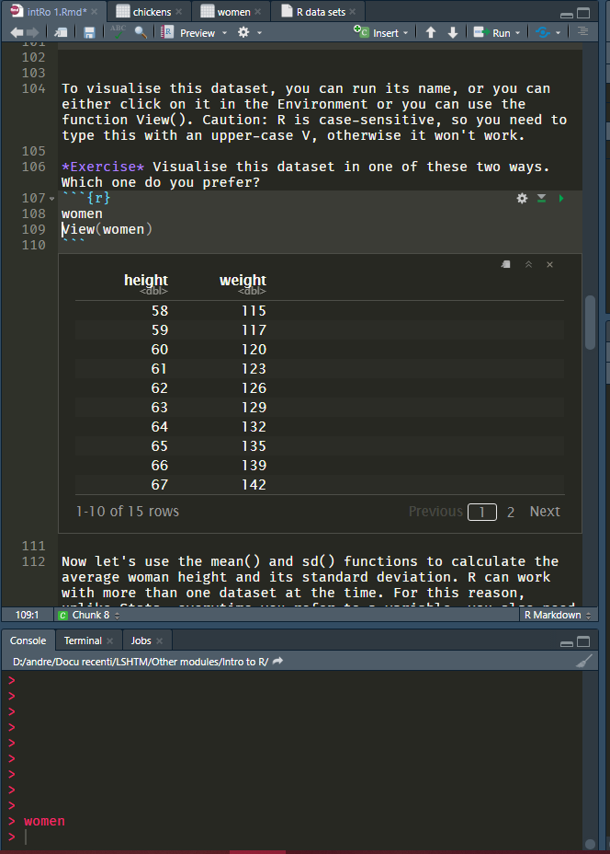
b) R Notebooks
main text
“chunk” of code
output of that chunk
chunks make it easier to find output
.

Slide 10
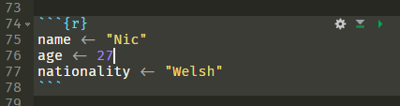
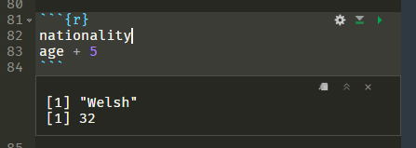
c) Assignment
< -
shortcut: Alt –
You ask R to remember something for you
.

Slide 11
d) Functions
ttest var1 == var2, unpaired
function
arguments
options
t.test(var1 ~ var2, data = dataset, unpaired = T)
function(ar1, ar2)
.

Slide 12

d) Functions as language
function
arguments
options
pipe
comment
VERB
NOUN
ADJECTIVE
CONJUNCTION
ANNOTATION
t.test(var1 ~ var2, data = dataset, unpaired = T)
him <- mobster
make(him, offer) %>%
accept()
# accept = not refused

Slide 13
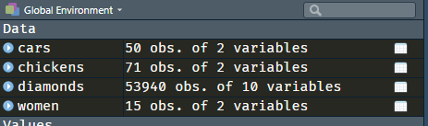
e) Datasets
R can open multiple datasets at a time
When you use a dataset, you need to specify which one:
When you use a variable, you need to specify which dataset it is from, with the $ sign:
summarize
mean size
summary(cars)
mean(cars$size)
More typing, but more flexibility
.

Slide 14




Packages
Only once:
Every time:
Pretty
graphs?
median()
Stata
files?
chi.sq.test()
Base R
.Rmd
.

Slide 15

Data import
use data.dta | ds1 <- read_dta(“data.dta”)
import delimited data.csv | ds2 <- read_csv(“data.csv”)
import excel using “data.xlsx” | ds3 <- read_excel(“data.xlsx”)
.

Slide 16
Explore data
browse | View(dataset)
 | dataset
describe | glimpse(dataset)
ds | names(dataset)
codebook | summary(dataset)
.

Slide 17
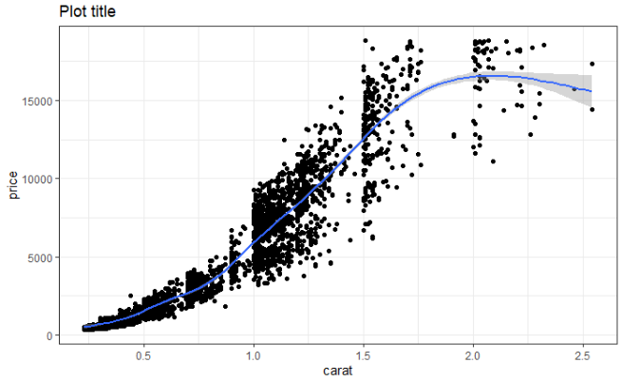
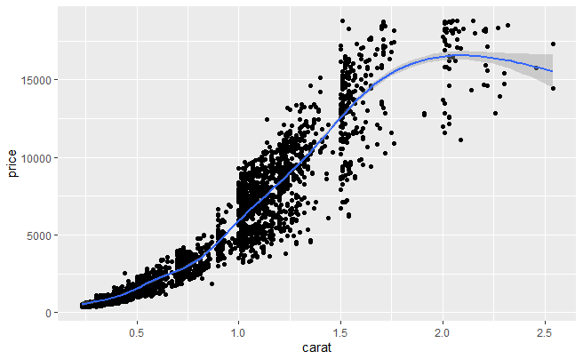
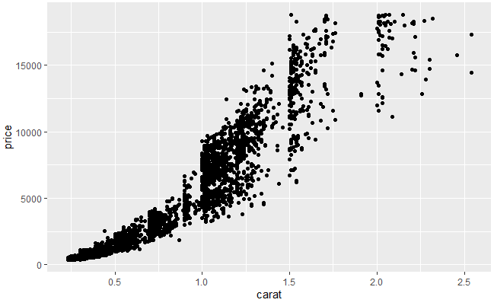
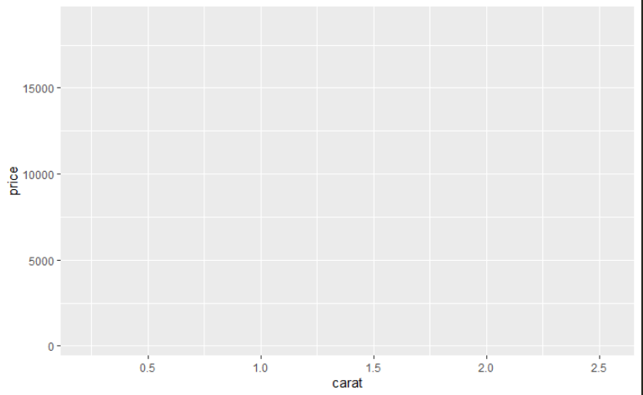
Graphing with
ggplot(dataset, aes(variables))
+
geom_point()
+
geom_smooth()
+
Syntax in “layers”, joined by + sign
labs(title = “Plot title”) +
theme_bw()
.
.

Slide 18
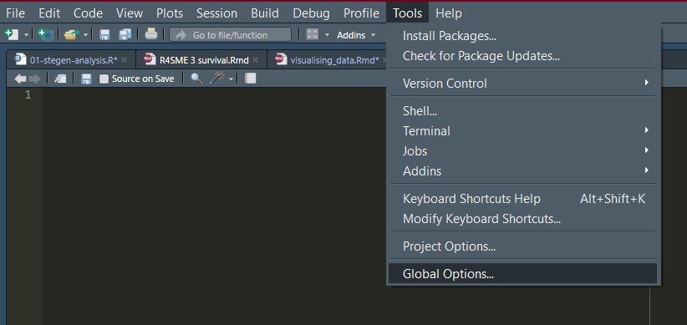
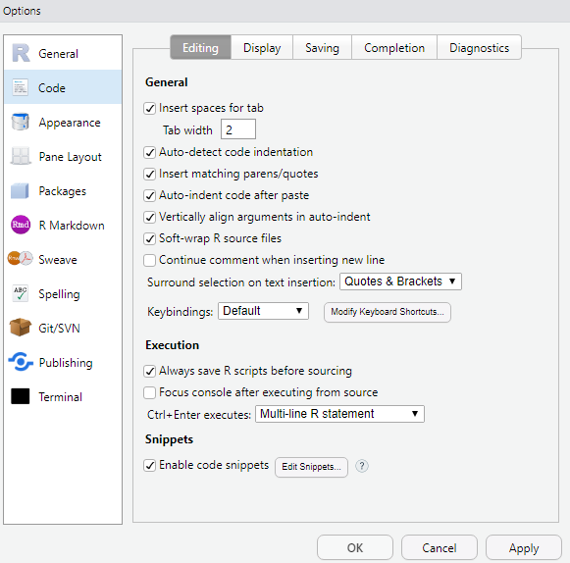
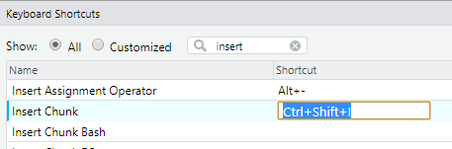
New chunk shortcut
Ctrl + Shift + I
.

Slide 19
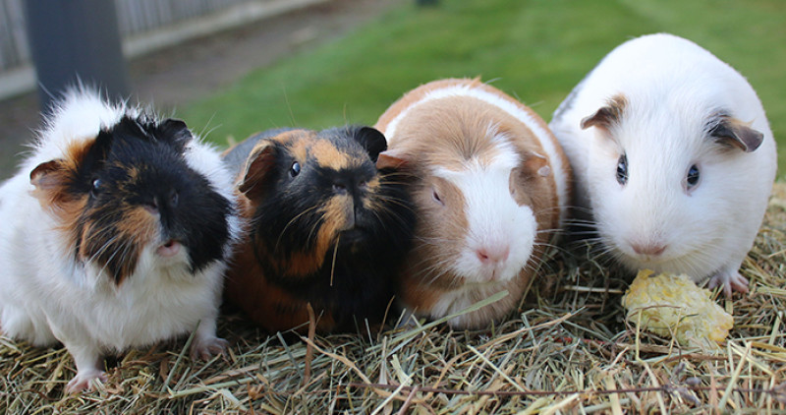

Pedagogical considerations: facilitation vs ‘teaching’
Visualising
Tidying
Practice
Summarising
Modelling

Slide 20
Data classes
Categorical
factor
Continuous
numeric (integer, double)
Text strings
character
Logical
logical
FALSE
0.05
2
"soft"
TRUE
NA
Dates
date
"2020-05-18"
.
class(object)
.

Slide 21
